Slide 1
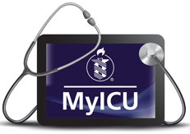
MyICU
Utilizing An Inpatient Portal In The ICU Setting To Enhance Patient, Family, And Provider Communication

Slide 2
MyICU: Mission Statement
The mission of the MyICU initiative is to improve physical and emotional outcomes of intensive care unit patients and their families through meaningful sharing of bi-directional information between patients, families and their care providers.
The overarching goals of MyICU are to:
Better align care with patient and family values and preferences
Avoid preventable harm through engaging patients and families as active partners in care
Enhance dignity and respect for patients and families by treating whole persons
Develop reproducible technologies that support the project goals and that can be disseminated to other units and institutions to amplify communication-focused, patient-centered care.

Slide 3
MyICU: Pilot Usage
Piloted in one Medical ICU and one Trauma Surgical ICU from October 2015 to January 2016
Enrolled 48 patients/families in MyICU
Used predominantly by families due to severity of illness of patients

Slide 4
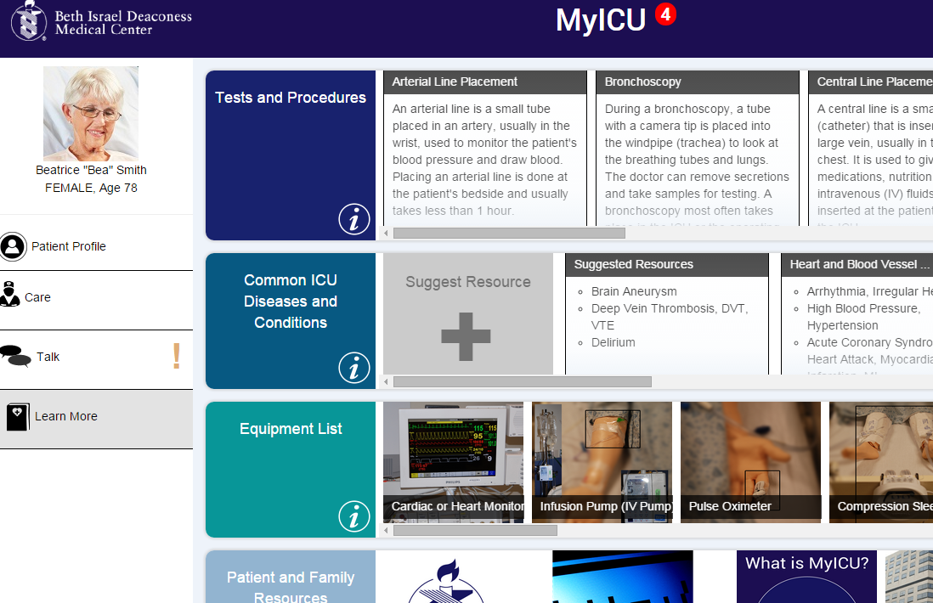
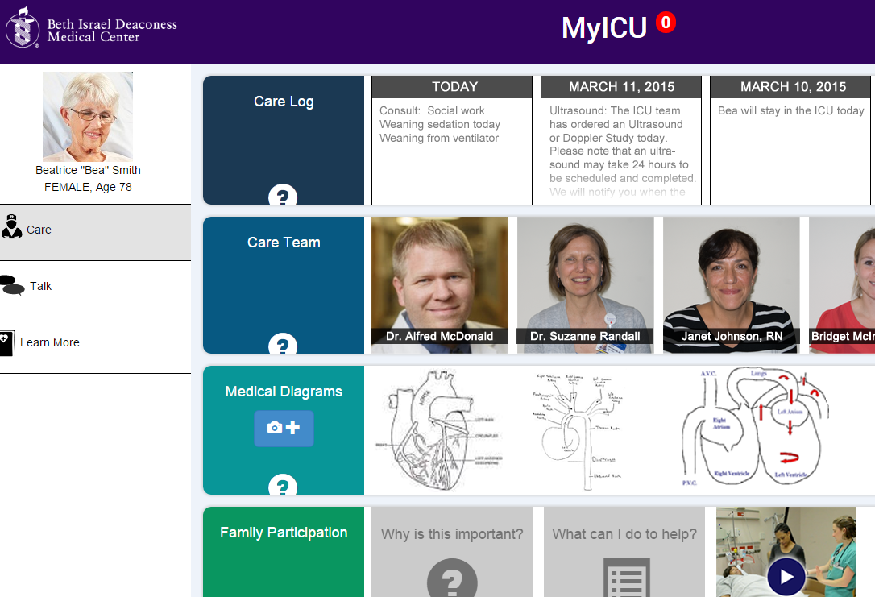
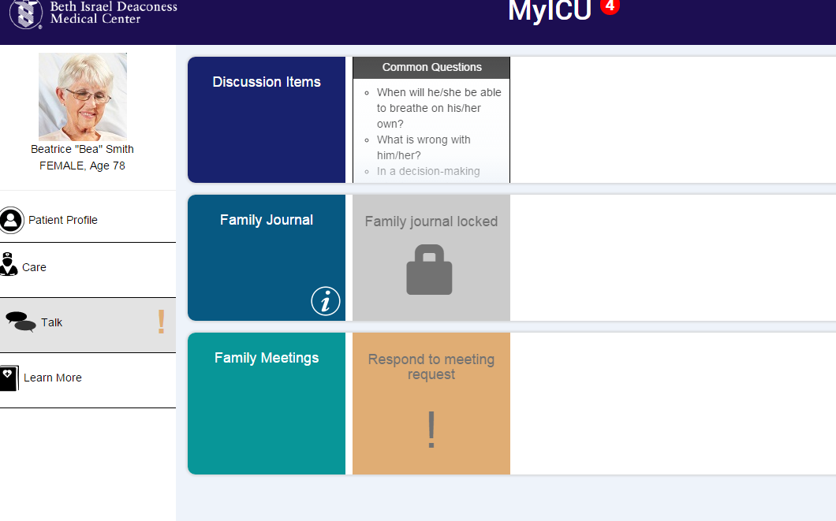
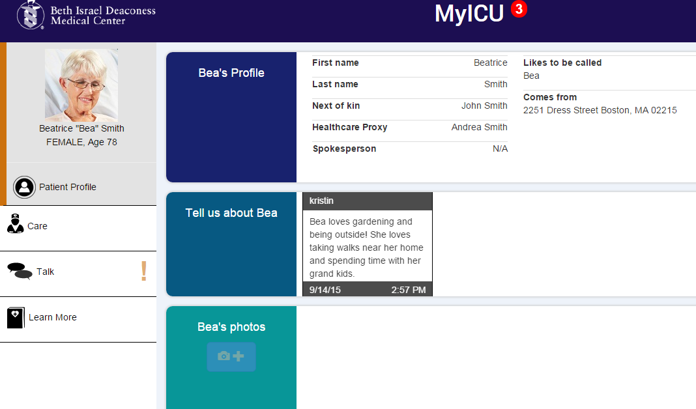
Version 1 Features

Slide 5
Feedback on Version 1
Family: “It was nice to add things about my mother – put down things about who she is so the team has some ‘common ground knowing’ about her.”
Staff: “Really helpful to know what a patient was like prior to hospitalization”
Family member: “I loved the equipment, conditions and test and procedure information!”
Staff: “I want to upload educational content specific to our department.”
Family Member: “Loved the care team! I am very bad with names so I really found it helpful to have the pictures and was disappointed that not all staff has a picture.”
Staff: “Can this integrate with our other IT systems?”
Notes:
Conducted in person surveys with patient/family users. Did an online survey for staff as well as in person feedback sessions.

Slide 6
Version 2 Improvements Based on Feedback
Notification flag in MetaVision that indicates when patient/family has interacted with MyICU
App redesigned to display on mobile devices, encourage BYOD
Created ability for patients/families to directly email/page pharmacy, social work and spiritual care
Simplified interface, removing features that were least used by patients.
Added ability for clinicians to upload specific content for a patient

Slide 7
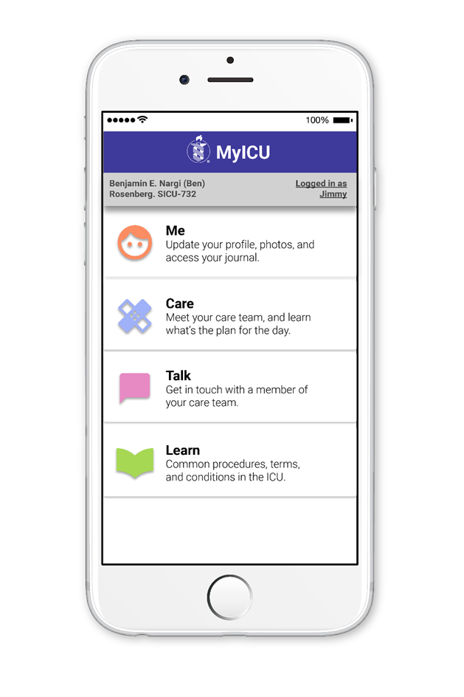
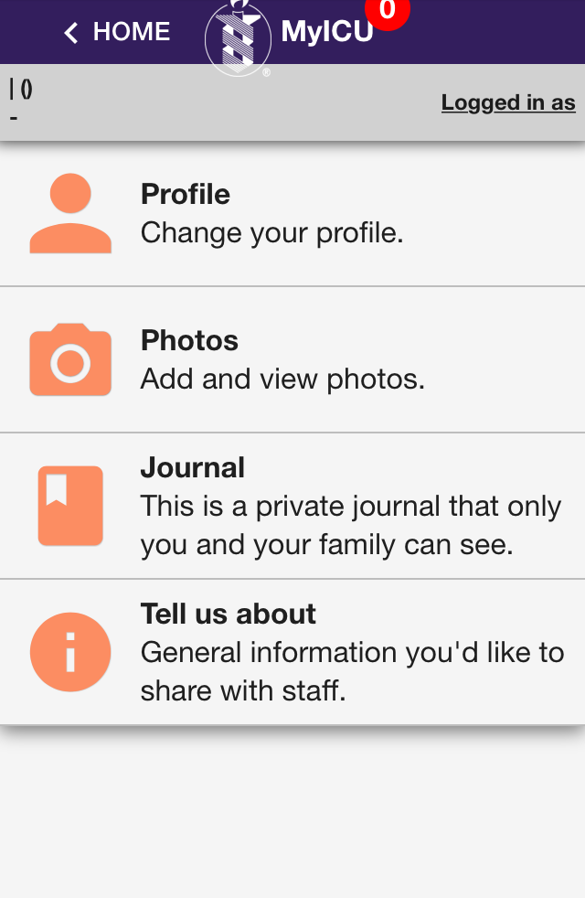
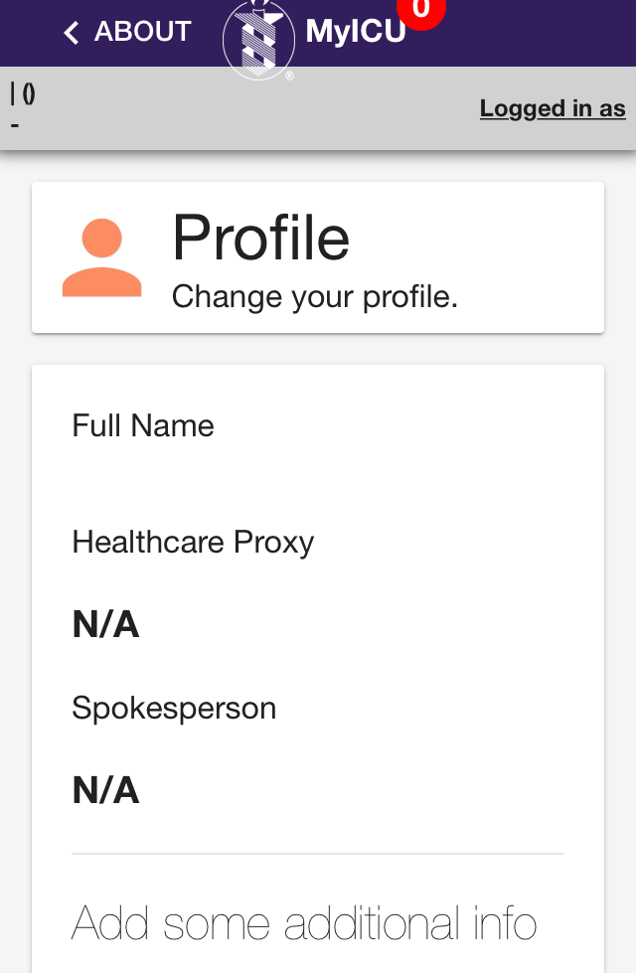
New Simplified/Mobile Friendly Design

Slide 8
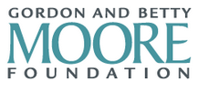
Contact Info:
Kristin O’Reilly, RN BSN MPH
Manager Critical Care Quality, BIDMC
koreilly@bidmc.harvard.edu
MyICU is funded by a grant from:

